Slide 1

RELIANCE INDUSTRIES STOCK FORECAST
P277 Group No. 3
Mentor - Neha Ramchandani
06-09-2023
Team- 1. Mr. Saurav Srikant Deshmukh
2. Mr. Tushar Yashwant Pansare
3. Mr. Rajiv Ranjan Kumar

Slide 2
OBJECTIVES
Predict the Reliance Industries Stock Price for the next 30 days.
There are Open, High, Low and Close prices that you need to obtain from the web for each day starting from 2000 to 2023 for Reliance Industries stock.
Split the last year into a test set- to build a model to predict stock price.
Find short term, & long term trends.
Understand how it is impacted from external factors or any big external events.
Forecast for next 30 days.

Slide 3
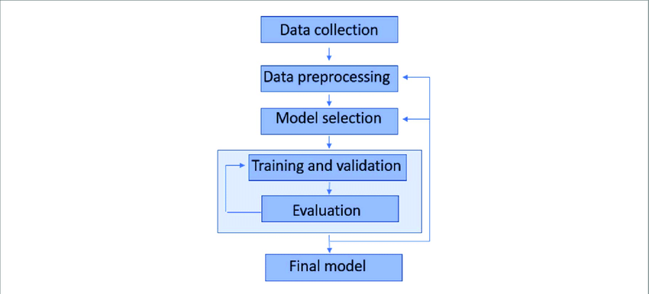
Project Architecture / Project Flow

Slide 4
DATA COLLECTION
For this project, we will be using the Yfinance library to get the data, which makes it easy to process.
We collected data from 1-Jan-2000 to 14-Aug-2023.
But also you can download data from ‘Yahoo! Finance’ website. You can use Below link.
https://query1.finance.yahoo.com/v7/finance/download/RELIANCE.NS?period1=946684800&period2=1691971200&interval=1d&events=history&includeAdjustedClose=true

Slide 5
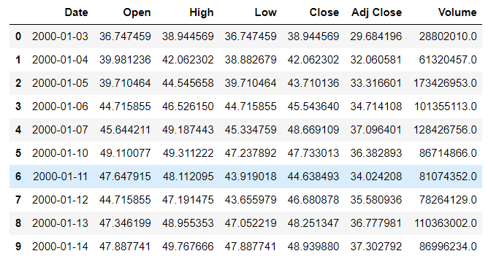

Slide 6
Date: Date of trade
Open: Opening Price of Stock
High: Highest price of stock on that day
Low: Lowest price of stock on that day
Close: Close price adjusted for splits.
Adj Close: Adjusted close price adjusted for splits and dividend and/or capital gain distributions.
Volume: Volume of stock on that day

Slide 7
DATA PREPROCESSING
For this dataset there were 10 null values which are now imputed by forward imputation method
There were zero duplicate records in the dataset
‘Date’ column was not in datetime datatype, it was in object so we changed it into datetime
Renamed the columns names
Set ‘Date’ column as index column for visualization purpose
There was no need of ‘Adj Close’ column so we removed it

Slide 8
Exploratory Data Analysis (EDA) and
Feature Engineering

Slide 9
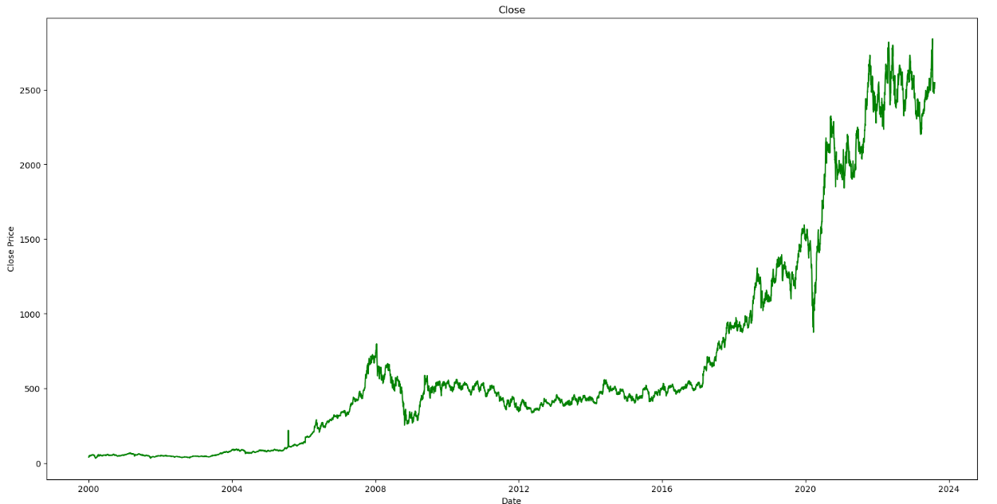
‘Close’ column plot according to year

Slide 10
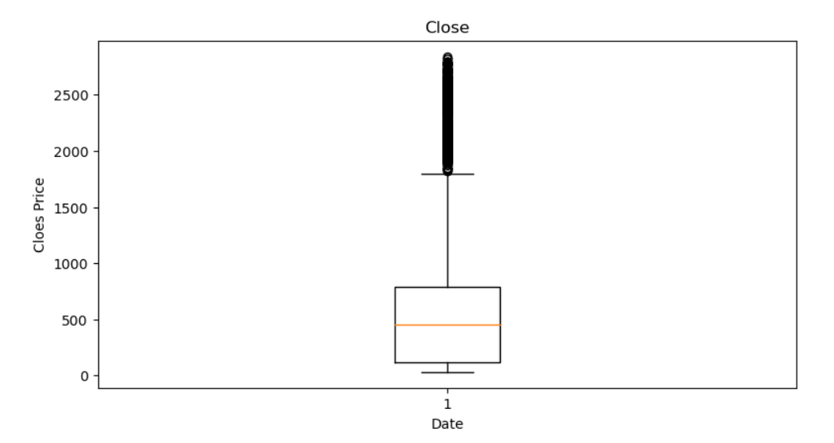
‘Close’ column boxplot

Slide 11
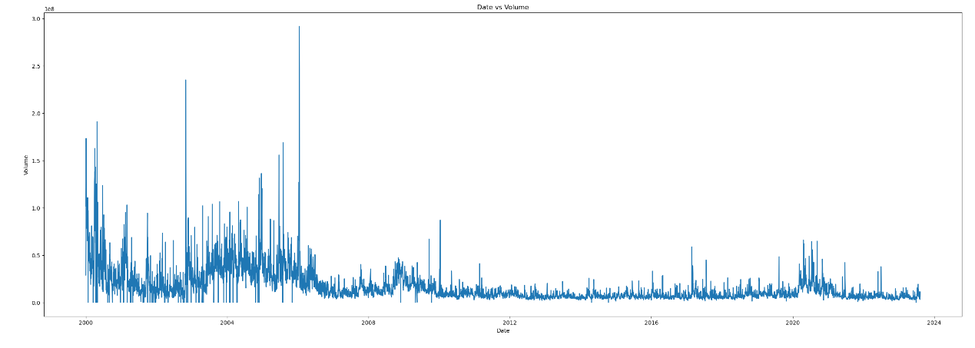
‘Volume’ column plot according to year

Slide 12
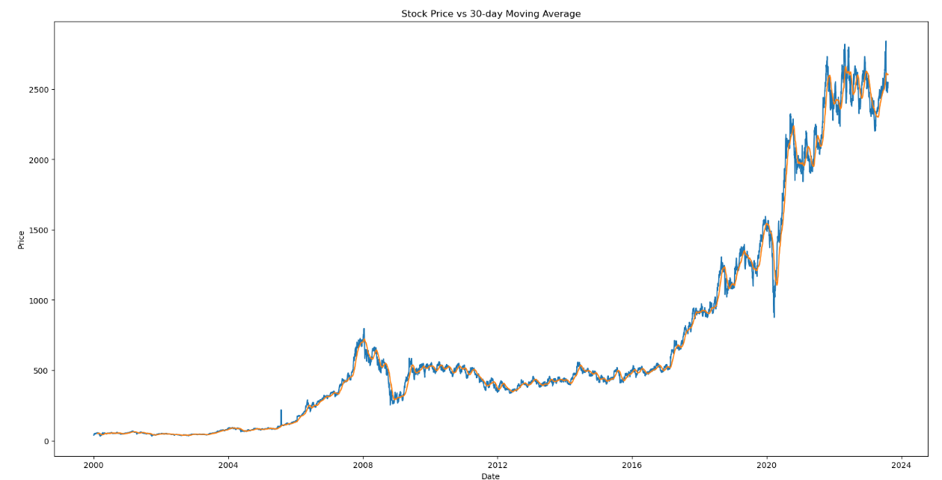
Stock price vs 30days moving average

Slide 13
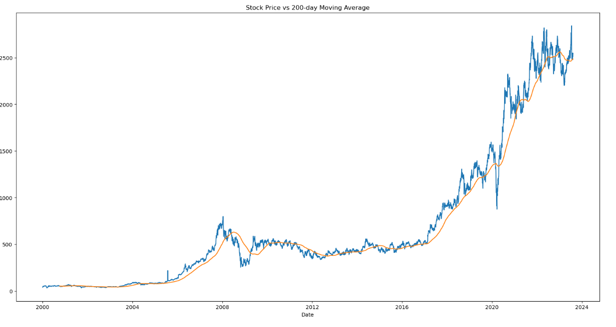
Stock price vs 220days moving average

Slide 14
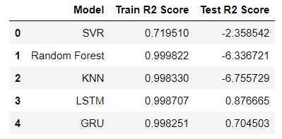
MODEL SELECTION
By Looking into this table we can say that our LSTM model have best R2 score. so we are going to use LSTM model for our deployment part.

Slide 15
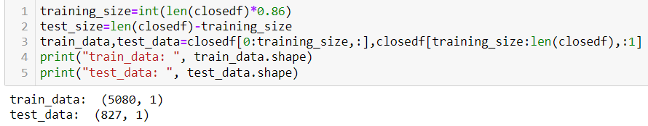
TRAINING AND VALIDATION
Ratio for training and testing data is 86:14

Slide 16
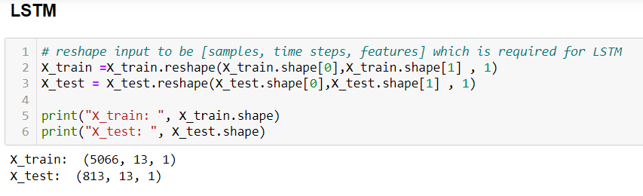
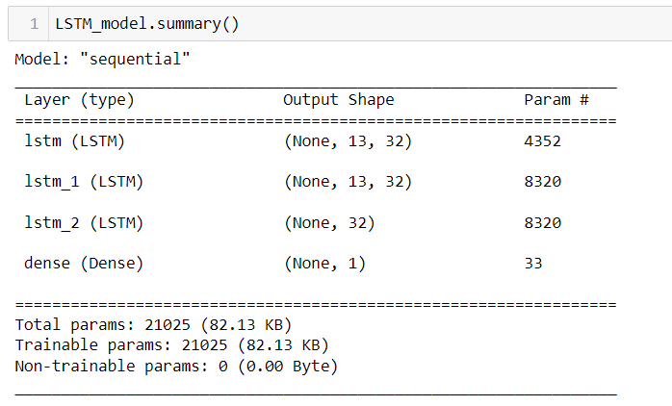

Slide 17
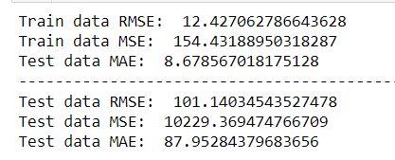

Slide 18
FINAL MODEL
Based on accuracy we choosed LSTM model as final model
LSTMs are predominantly used to learn, process, and classify sequential data because these networks can learn long-term dependencies between time steps of data.
Common LSTM applications include sentiment analysis, language modeling, speech recognition, and video analysis.
Long Short-Term Memory (LSTM) is a type of Recurrent Neural Network (RNN) that is specifically designed to handle sequential data, such as time series, speech, and text.
LSTM networks are capable of learning long-term dependencies in sequential data, which makes them well suited for tasks such as language translation, speech recognition, and time series forecasting.

Slide 19
DEPLOYMENT
What is Streamlit?
Streamlit is a free and open-source framework to rapidly build and share beautiful machine learning and data science web apps.
It is a Python-based library specifically designed for machine learning engineers.
The best thing about Streamlit is that you don't even need to know the basics of web development to get started or to create your first web application.
So if you're somebody who's into data science and you want to deploy your models easily, quickly, and with only a few lines of code, Streamlit is a good fit

Slide 20
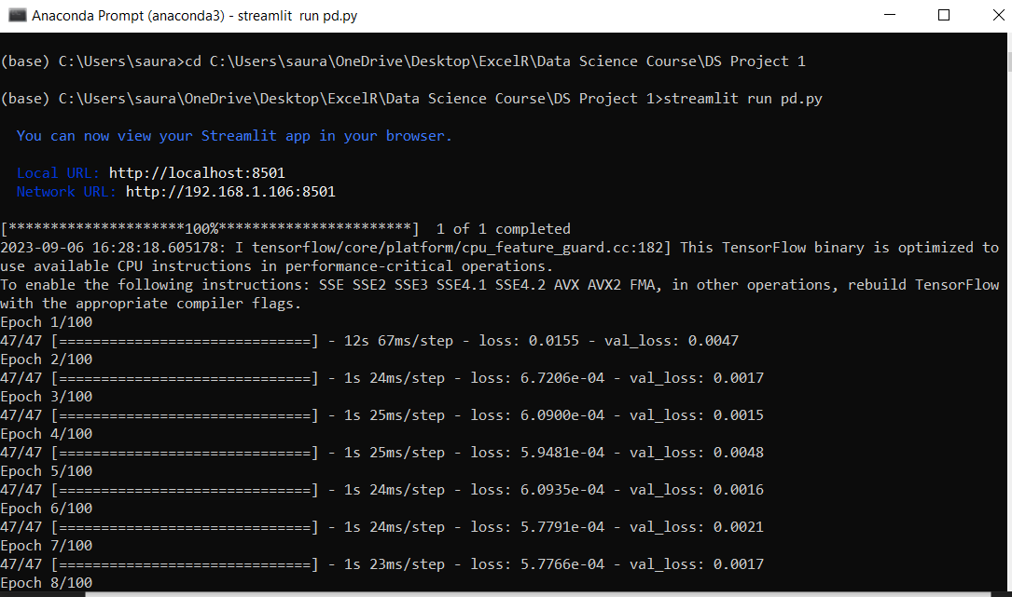
Running Streamlit in anaconda prompt

Slide 21
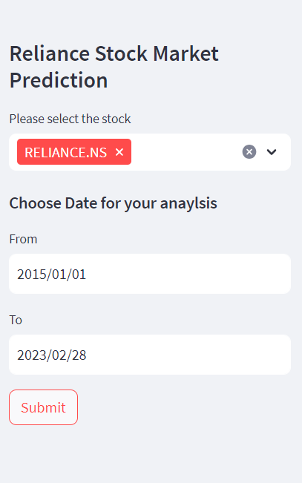

Slide 22
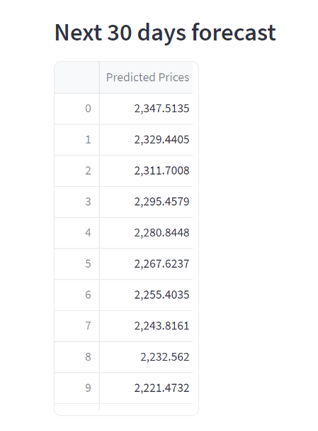
DEPLOYMENT

Slide 23
CHALLANGES FACED
Data Quality and Availability: Obtaining reliable and comprehensive historical stock data for Reliance Industries proved challenging. We faced issues related to missing data points, data inconsistencies, and limited historical data, which required extensive data cleaning and preprocessing.
Feature Engineering: Selecting and engineering relevant features for our LSTM model was a critical aspect of our project. We had to make tough decisions regarding feature selection and transformation to improve the model's predictive power.
Model Complexity: LSTM models can be prone to overfitting or underfitting due to their complexity. We had to fine-tune the model architecture and regularization techniques to strike the right balance between model complexity and predictive accuracy.
Hyperparameter Tuning: Tuning the hyperparameters of our LSTM model was a non-trivial task. We explored various combinations of hyperparameters to optimize model performance, which required significant computational resources and time.
Data Preprocessing: Preprocessing the data, including scaling, normalization, and handling imbalanced data, presented its own set of challenges. These preprocessing steps were essential to ensure that the model could effectively learn from the data.

Slide 24
HOW WE OVERCAME IT
Data Quality and Availability: To address data quality issues, we conducted thorough data cleaning, removing or imputing missing values and rectifying inconsistencies. We employed web scraping techniques to retrieve additional historical data, expanding our dataset and mitigating the issue of limited data availability.
Feature Engineering: Extensive domain research and consultation with financial experts guided our feature selection process, ensuring that we included relevant and meaningful features. Feature scaling and transformation techniques were applied to improve the compatibility of features with our LSTM model.
Model Complexity: We implemented regularization techniques, such as dropout layers, to prevent overfitting in our LSTM model. Cross-validation was employed to fine-tune hyperparameters and monitor the model's performance on validation data, helping to strike the right balance.
Hyperparameter Tuning: Grid search and random search methods were utilized to explore a wide range of hyperparameter combinations efficiently. Cloud-based computing resources, like AWS or Google Cloud, were leveraged to speed up the hyperparameter tuning process.
Data Preprocessing: We applied advanced preprocessing techniques, such as robust scaling and imputation strategies, to handle imbalanced data and minimize the impact of outliers. Feature engineering and selection were integrated into the preprocessing pipeline to streamline the workflow.

Slide 25
Thank you

